Slide 1

WELCOME
CONFIGURATION
FOR
GENERAL LEDGER
ACCOUNTING(FI)
Compiled By S.N.HEGDE

Slide 2
Topics
Document Parking and Holding
Recurring Entry/Sample Documents
Currency Translation
Validation & Substitution
Posting Amount Defaults & Tolerance Groups
Interest Calculation
Reports

Slide 3
Document Parking &
Holdings

Slide 4
Temporary Savings
Parking of Documents
Before posting
- System generates number.
After posting
- Parked doc. gets the same number as earlier
Holding of Documents
Before posting
- User has to give the name / number to the document
After posting
- Held doc. gets deleted and number will be generated by the system.
At this level both documents can be modified and even can be deleted. But no account gets updated and are not available for evaluation.

Slide 5
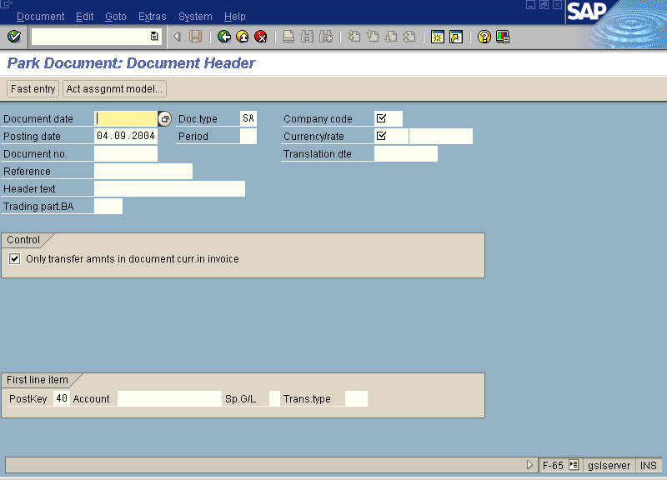

Slide 6
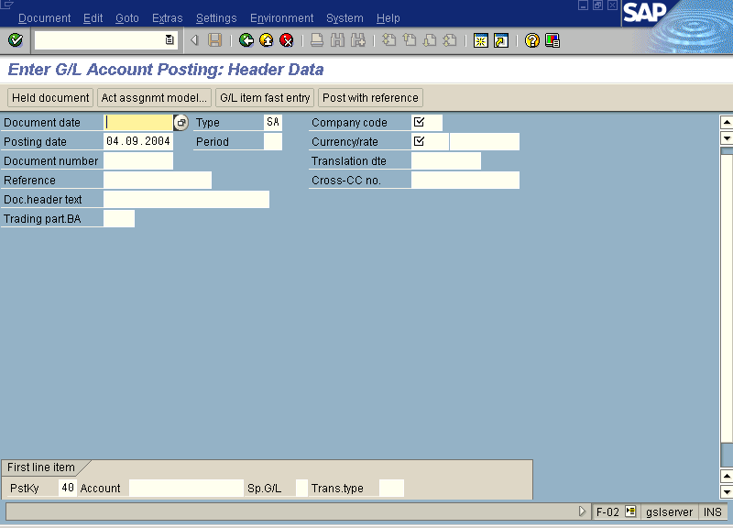

Slide 7
Reference Documents
You can post documents by giving reference to earlier posted documents or even calling a template with default line items which can be changed, added, deleted at the time of actual posting.
Account assignment model
- A template with default line items can be created and can be called for any number of times.
- To update the document you need to ‘Post’ explicitly.

Slide 8
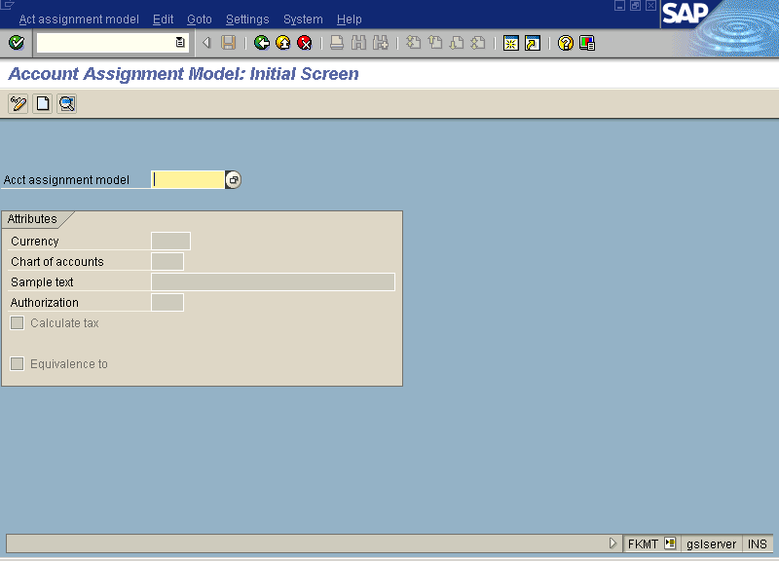

Slide 9
B) RECURRING ENTRY /
SAMPLE DOCUMENTS

Slide 10
RECURRING ENTRY /
SAMPLE DOCUMENTS

Slide 11
C) CURRENCY
TRANSLATION

Slide 12
CURRENCY
TRANSLATION

Slide 13
D) VALIDATION
& SUBSTITUTION

Slide 14
VALIDATION & SUBSTITUTION
Validations are used to check settings and return message if the prerequisite check condition is met.
You can use validations to supplement existing SAP logic to fit your business needs.
A validation is a valuable tool that can be used in many of the financial and controlling modules.
Eg., a particular company code can be restricted to particular business area

Slide 15
VALIDATION & SUBSTITUTION
To get to the validation configuration, use following menu : Financial Accounting -> Special Purpose Ledger -> Tools -> Maintain Validation / Substitution / Rules -> Maintain Validation
Transaction code : GGB0

Slide 16
VALIDATION & SUBSTITUTION
Substitutions are similar to validation. But unlike validation which create on-screen messages to the user substitution actually replace and fill in field values behind the scene without the user’s knowledge .
Similar to validations, substitutions can be set up for a number of different application areas and callup points.
Substitutions are activated on the company code level, so it is important to follow all steps for company code.

Slide 17
VALIDATION & SUBSTITUTION
To get to the substitution configuration, use following menu : Financial Accounting -> Special Purpose Ledger -> Tools -> Maintain Validation / Substitution / Rules -> Maintain Substitution
Transaction code : GGB1

Slide 18
E) POSTING AMOUNT
DEFAUTS
& TOLERANCE GROUPS

Slide 19
POSTING AMOUNT DEFAUTS
& TOLERANCE GROUPS

Slide 20
F) INTEREST
CALCULATION

Slide 21
Interest Calculation
Interest Calculation configuration allows you to charge interest on overdue accounts. The system keeps track of the last interest run and stores it in customer master record.
The first step to configuring interest calculation is to create an interest indicator. For interest to be calculated on a customer, the interest indicator must stored in the customer master record. Interest can be calculated by using line items or overall account balances.

Slide 22
Interest Calculation
You can get to the Interest Indicator configuration screen with the following menu path :
Financial Accounting -> Accounts Receivable and Accounts Payable -> Business Transactions -> Interest Calculation -> Interest Calculation Global Settings -> Define Interest Calculation Type
Transaction code: OB46

Slide 23
Interest Calculation
After interest indicator has been created, the next step is to make it available to the interest run program.
When you make the interest indicator available to the interest run program, you also specify additional characteristics about how you want the indicator to function.

Slide 24
Interest Calculation
You can get to the Interest Indicator Available to the Interest Run Program with the following menu path :
Financial Accounting -> Accounts Receivable and Accounts Payable -> Business Transactions -> Interest Calculation -> Interest Calculation Global Settings -> Prepare Interest on Arrears Calculation
Transaction code: OB82

Slide 25
Interest Calculation
After interest calculation program, the next step is to determine the interest rate that will be used by the calculation.
The first step in determining the interest rate is to define reference interest rate.
Reference interest rates are a key by which specific interest rates are assigned to specific period.

Slide 26
Interest Calculation
For Creating Reference Interest Rates , use following menu path :
Financial Accounting -> Accounts Receivable and Accounts Payable -> Business Transactions -> Interest Calculation -> Define Reference Interest Rates
Transaction code: OBAC

Slide 27
Interest Calculation
After reference interest rate has been created, the next step is to assign interest indicator to reference interest rate.
The relationship to between interest indicator and reference interest rates is time dependant. Hence, one can configure interest indicators to use different interest rates in future.

Slide 28
Interest Calculation
For Assigning Reference Interest Rates to Interest Indicator, use following menu path :
Financial Accounting -> Accounts Receivable and Accounts Payable -> Business Transactions -> Interest Calculation -> Define Time dependant Terms
Transaction code: OB81

Slide 29
Interest Calculation
The final configuration step needed to make the interest calculation program work is to determine how and which accounts the interest program will post.
The interest calculation program does not use the automatic account determination. It uses its own posting interface to determine the accounts in stead of using posting keys. However, the posting interface functions in the same way account determination via process key functions.

Slide 30
Interest Calculation
To get the configuration screen for Interest Rates Account Assignment , use following menu path :
Financial Accounting -> Accounts Receivable and Accounts Payable -> Business Transactions -> Interest Calculation -> Interest Posting -> Prepare Interest on Arrears Calculation ( Customer).
Transaction code: OBV1

Slide 32
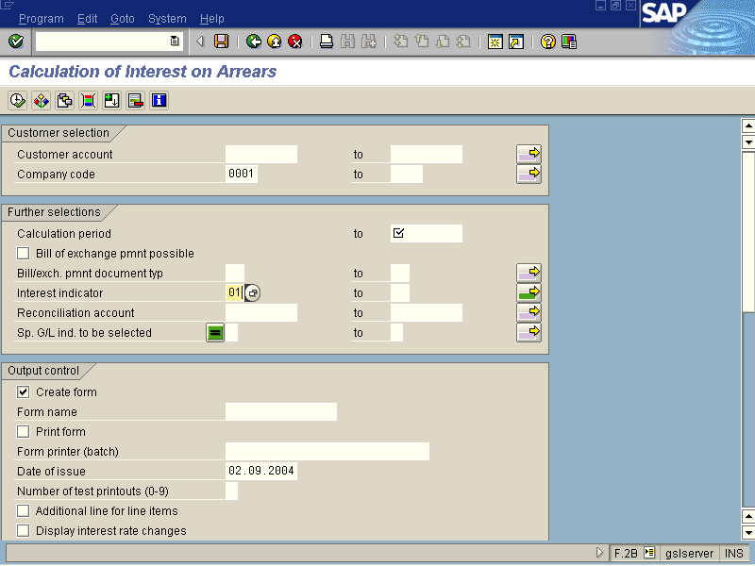

Slide 33
G) REPORTS

Slide 34
Reports
Various predefined reports are available in the system which we use very often.
GL account balances, document list, line item wise display, Balance sheet and Profit & Loss statements, account master record list and many more.
For customize reports functional person (even end user) can create reports by using tools provided by SAP or can take help of ABAP programmers.

Slide 35
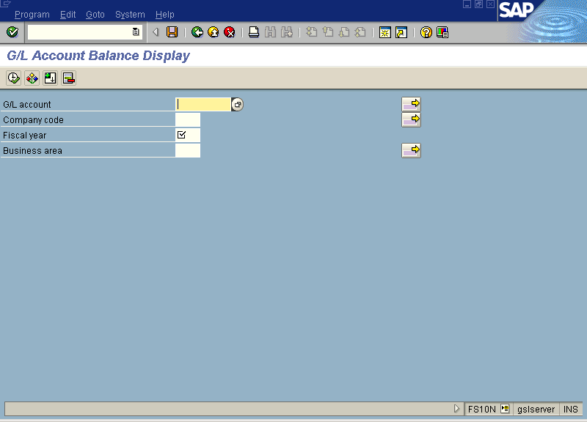

Slide 36
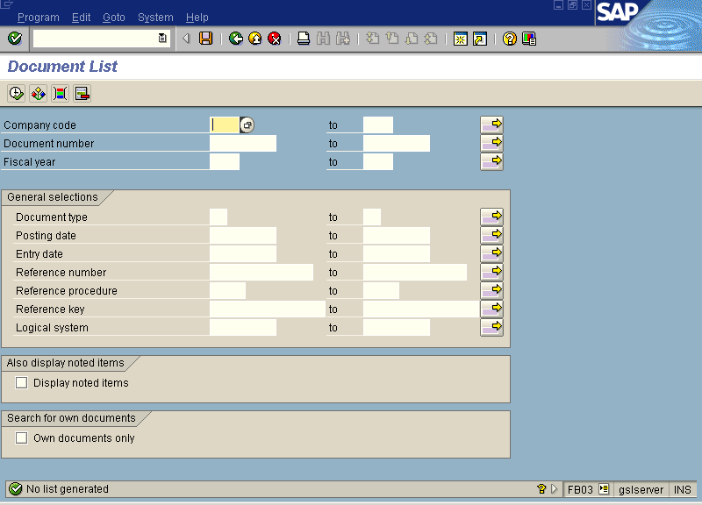

Slide 37
